Slide 1
Prelim Figures
5-29-2020

Slide 2
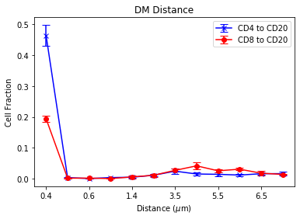
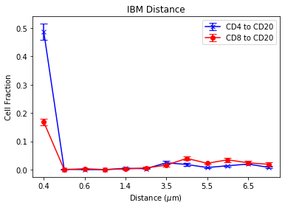
Short distance histograms
I at least need to work on the x-axis formatting here
Don’t know if an axis break, or changing tick spacing or x-point spacing is best
I can try these other options (it wasn’t immediately obvious how to get it work)

Slide 3
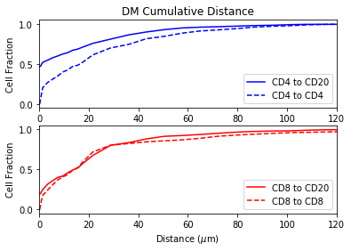
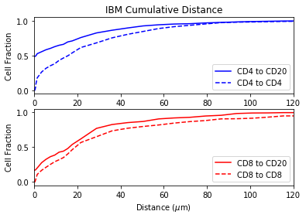
Cumulative distance histograms
Or, as an example on the next slide (only showing one) can do individual graphs and not have CD4 and CD8 subgraphs

Slide 4
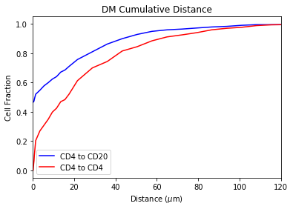
Cumulative distance histogram: Example 2

Slide 5
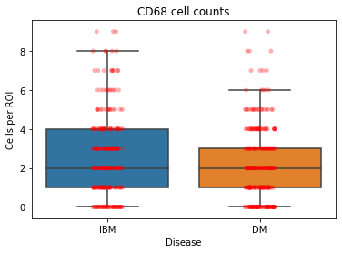
CD68 cell counts-box plot with overlaid points
I struggled the most with this plot but can make any changes necessary.
I also have cell count data for DC and Lymphocytes, so I can make plots for them as well
but not sure if we want them plotted this way
On the last slide I have the lymphocyte data as we plotted it previously for reference

Slide 6
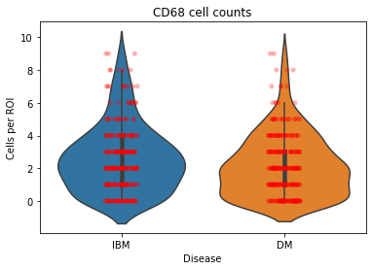
CD68-violin plot
One alternative I found for the previous plot is a violin plot which uses a kernel density estimation for the box shape

Slide 7
Cell counts with Mean and Standard Error
Lymphocyte data as previously plotted with Prism for reference

